Slide 1
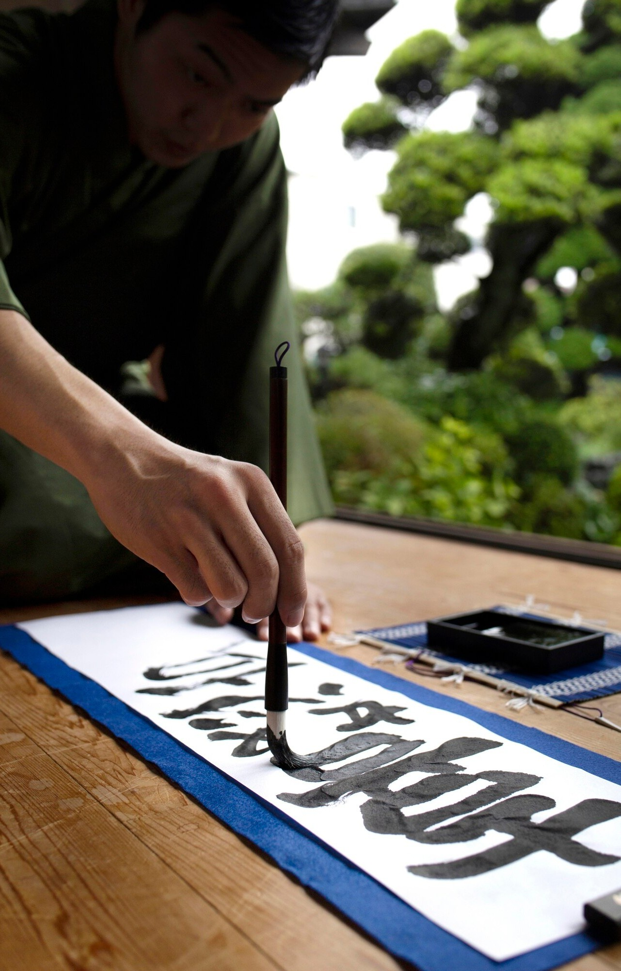
Visualizing the Solving Process: A Sudoku Solver Presentation

Slide 2

Introduction to Sudoku Solving
This presentation will explore the process of solving Sudoku puzzles using a programmatic approach. We will discuss the underlying algorithms, strategies, and techniques employed to efﬁciently solve these logic-based number placement problems.

Slide 3
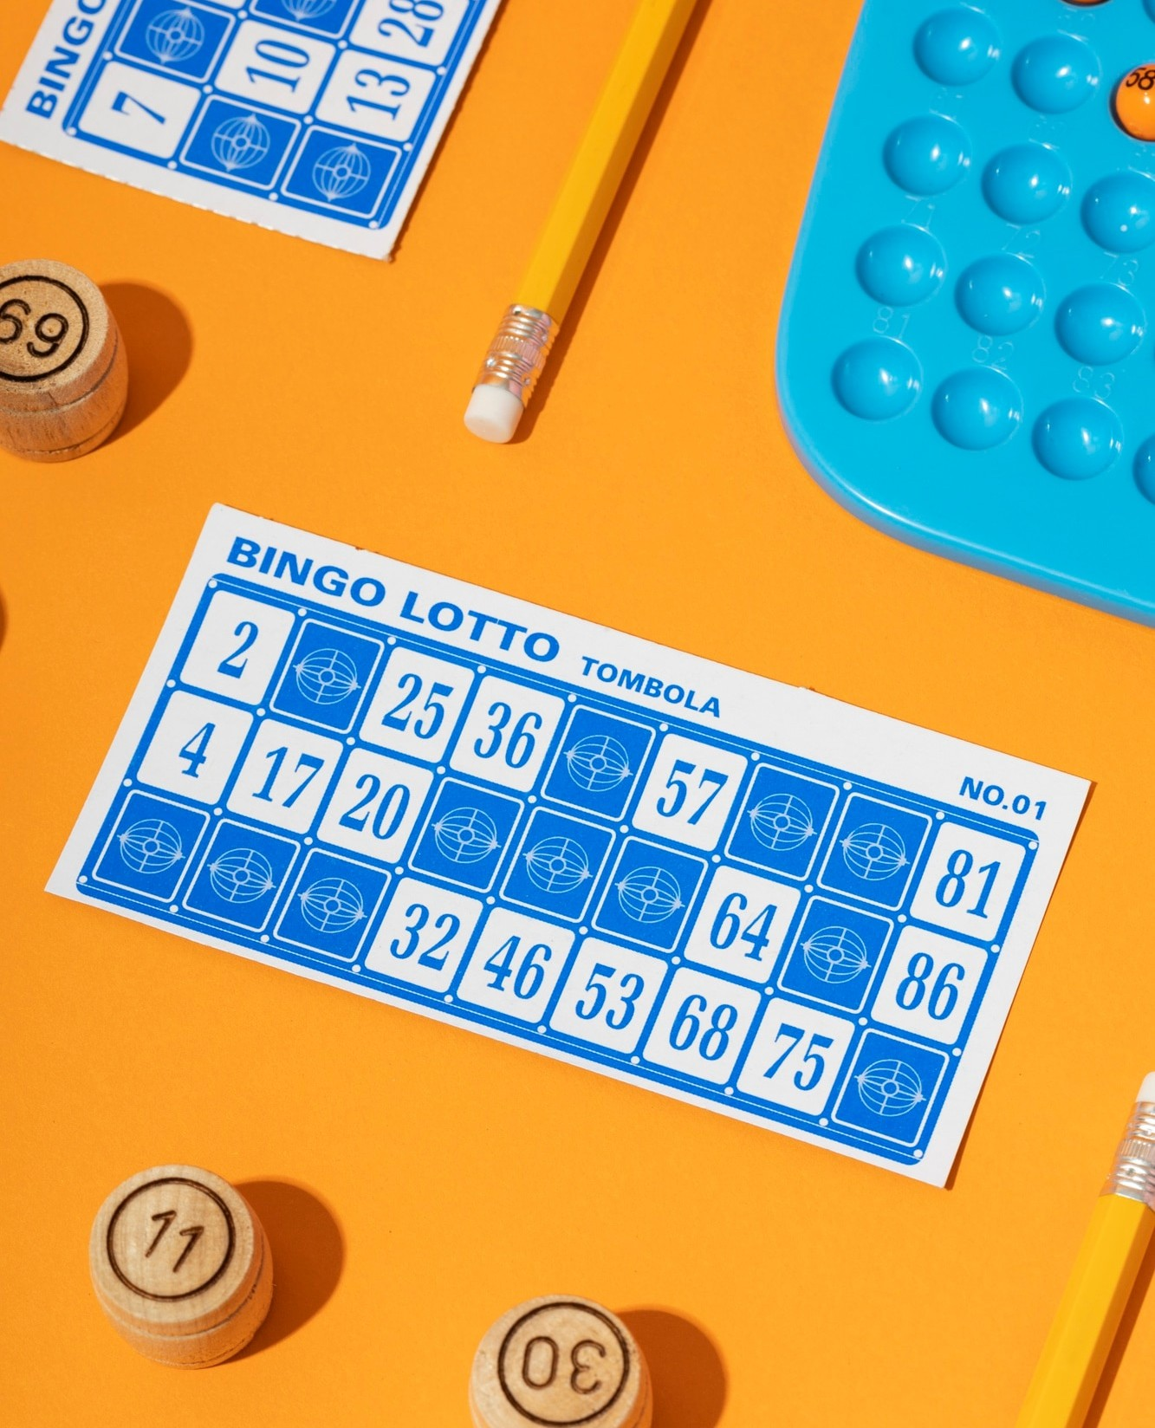


Understanding the Sudoku Grid
Sudoku is played on a 9x9 grid that is subdivided into 9 3x3 subgrids. The objective is to ﬁll the grid with digits from 1 to 9, ensuring that each row, column, and 3x3 subgrid contains all the digits without any repetition.

Slide 4


Backtracking Algorithm for Sudoku Solving
The backtracking algorithm is a widely used technique for solving Sudoku puzzles. It involves recursively trying different combinations of numbers in the empty cells, backtracking when a solution is not possible, and continuing the search until a valid solution is found.

Slide 5


Constraint Propagation and Optimization
To enhance the efﬁciency of the backtracking algorithm, constraint propagation techniques can be employed. This involves using the given clues to identify and eliminate possible values in the empty cells, reducing the search space and improving the solver's performance.

Slide 6
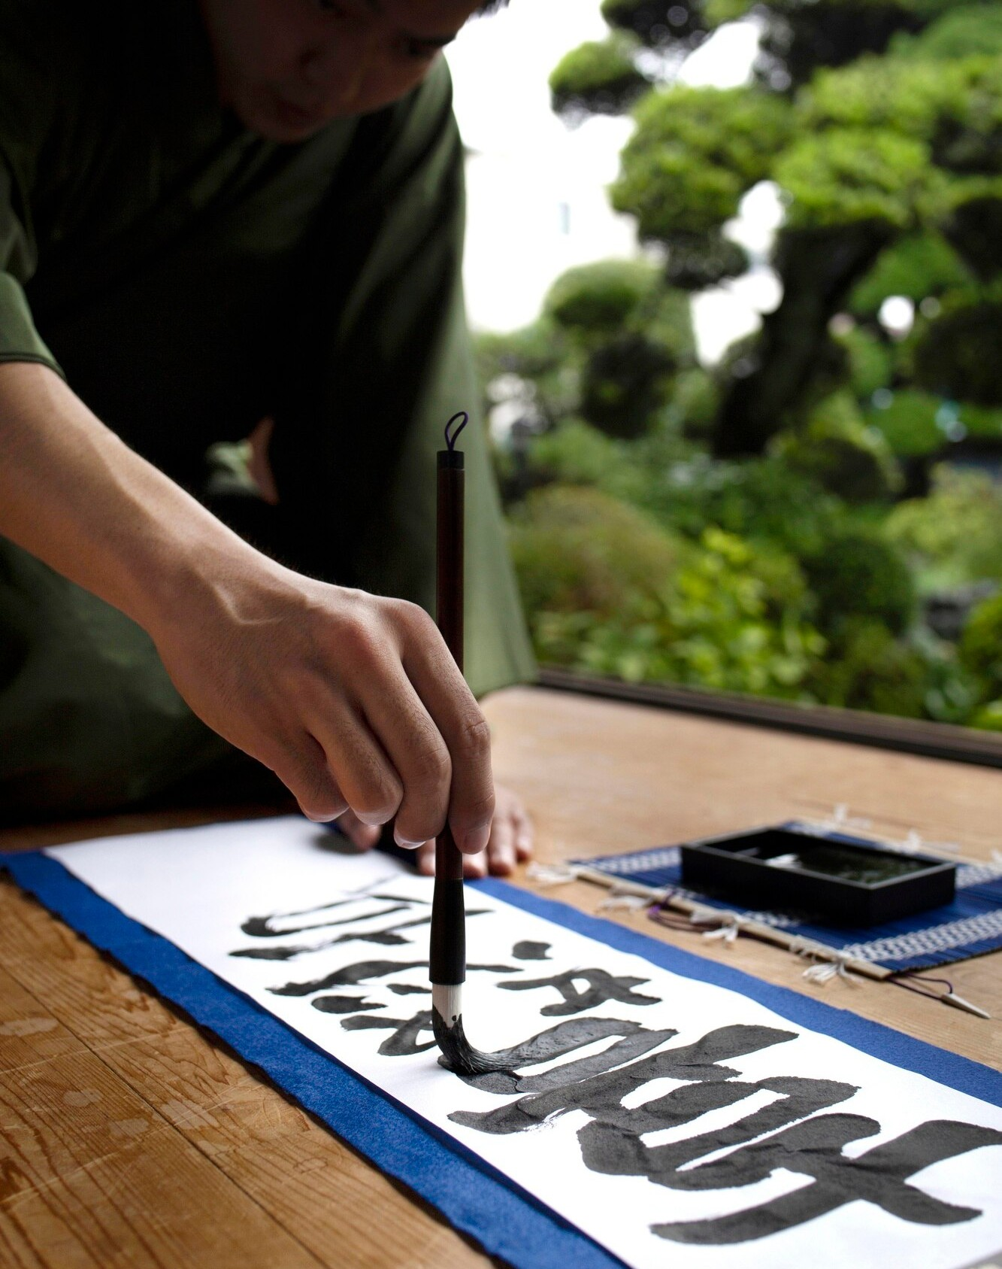

Techniques for Solving Advanced Sudoku Puzzles
Sudoku puzzles can range in difﬁculty from easy to extremely challenging. Advanced solving techniques, such as hidden singles, naked pairs, and X-wing patterns, can be utilized to tackle more complex Sudoku grids effectively.

Slide 7
Conclusion: Mastering Sudoku Solving
In conclusion, this presentation has provided an overview of the algorithmic approaches and strategies used to solve Sudoku puzzles. By understanding the underlying principles and techniques, you can develop the skills to tackle Sudoku puzzles of varying difﬁculty levels with conﬁdence.

Slide 8
Thanks!

